Slide 1
#1: Visualization of Learned Features for Bat Species Classification
- 14 species of bats, visually very similar to each other
- Goal: provide some interpretability how a neural network classifies them

Slide 2
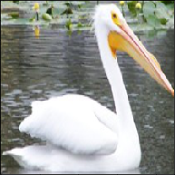
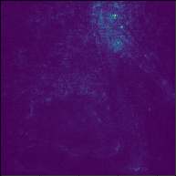
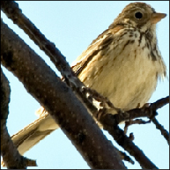
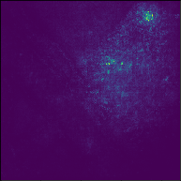
#1: Visualization of Learned Features for Bat Species Classification
- Saliency visualization via gradient backpropagation
- Integrated Gradients:
https://keras.io/examples/vision/integrated_gradients/
https://arxiv.org/abs/1703.01365
- SmoothGrad:
https://arxiv.org/abs/1706.03825

Slide 3
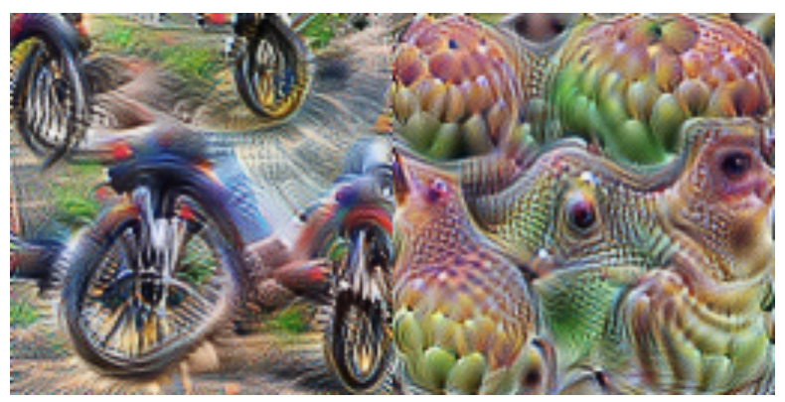
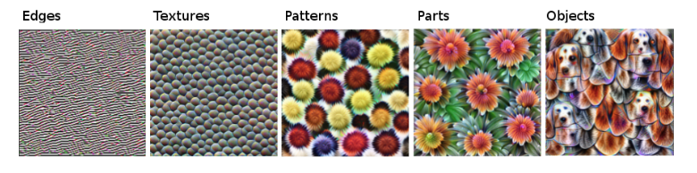
#1: Visualization of Learned Features for Bat Species Classification
- Feature visualization via image optimization
- https://distill.pub/2017/feature-visualization/
- https://christophm.github.io/interpretable-ml-book/cnn-features.html

Slide 4
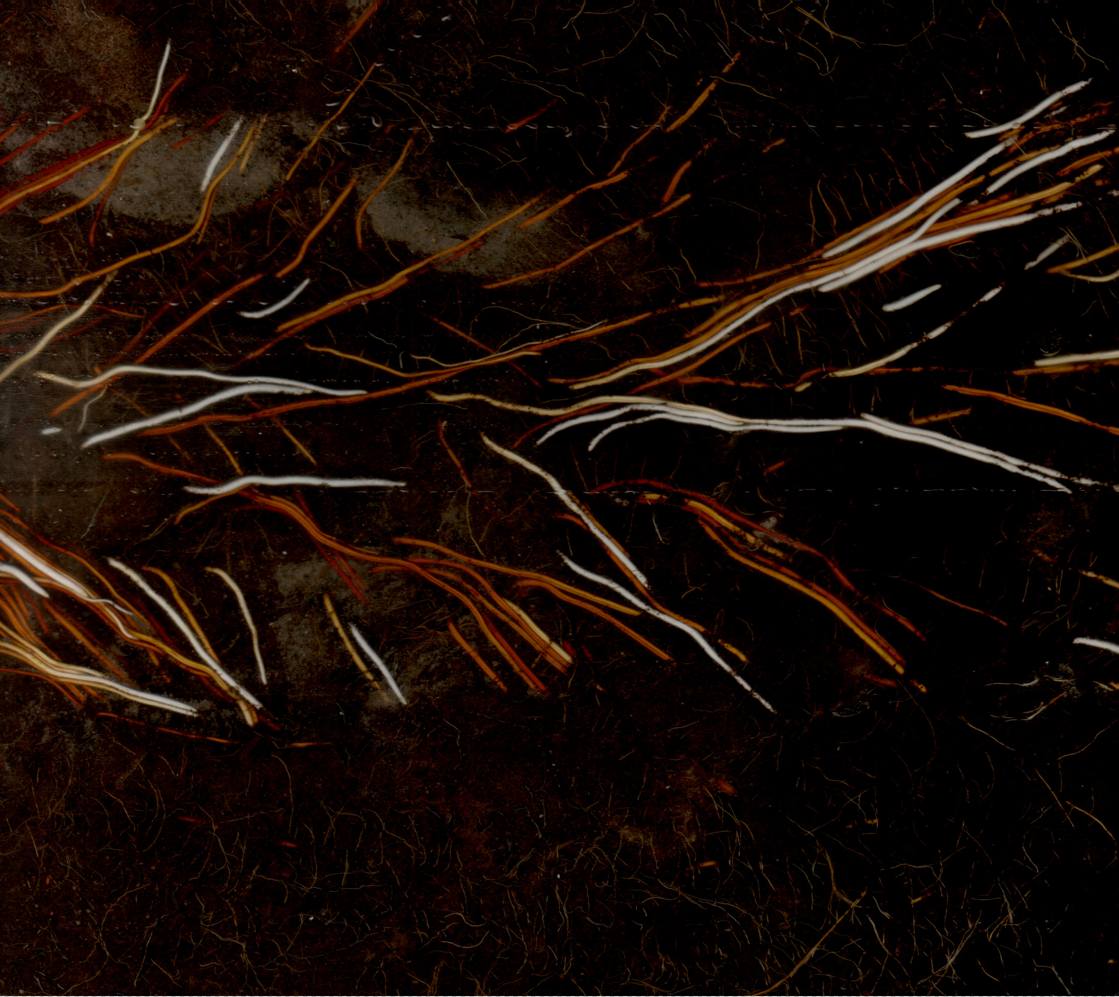
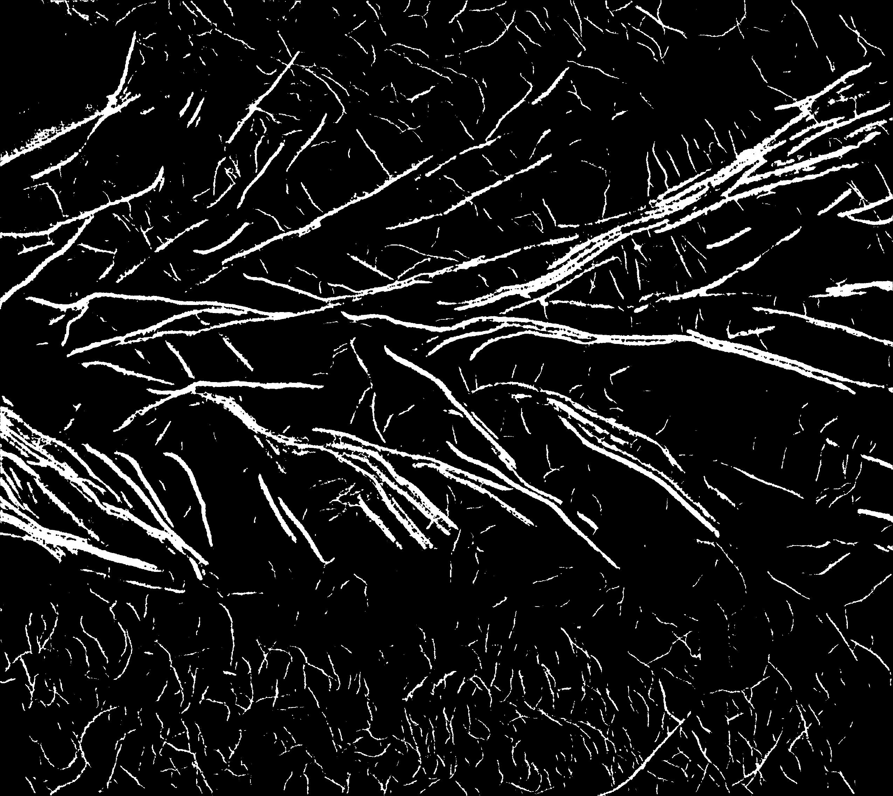
#2: Vectorization of Segmented Roots
Images of plant roots acquired with Mini-Rhizotrons

Slide 5
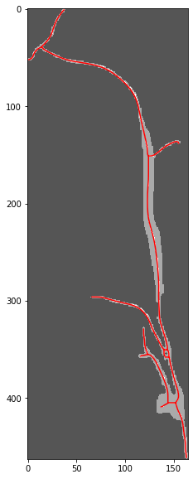
#2: Vectorization of Segmented Roots
Goal: Converting a segmentation map to a vector map
Better estimation of root lengths, thickness and branching

Slide 6
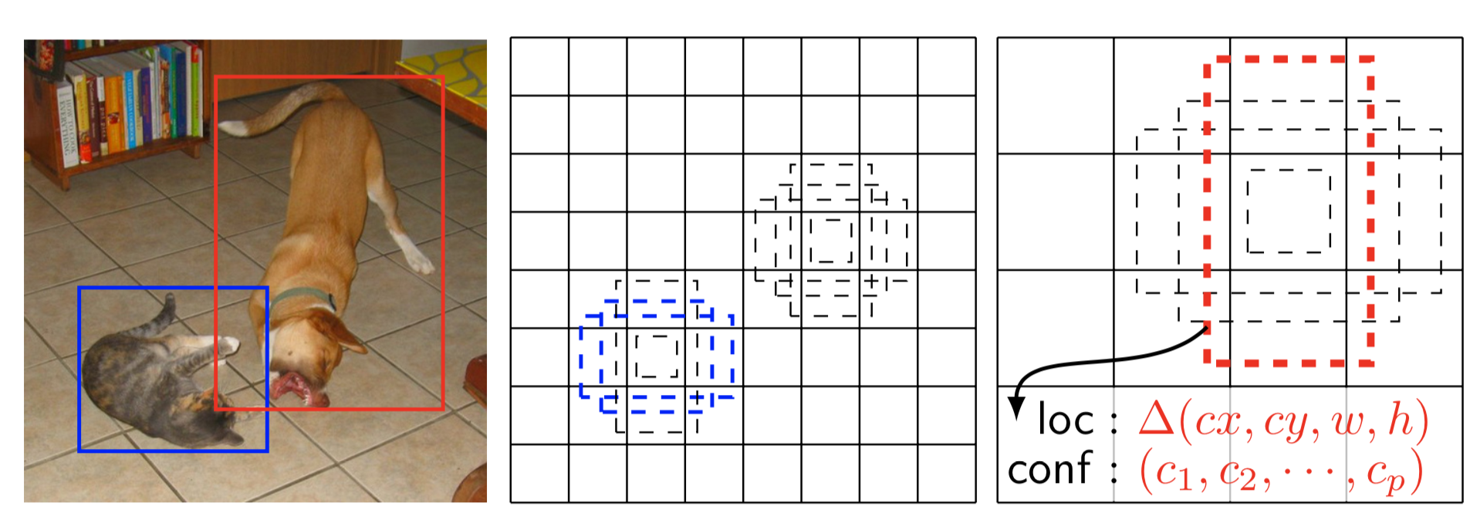
#3: Bezier Line Object Detection
Object Detection with anchor boxes: well researched topic
Anchors are templates that get modified by 4 parameters (x,y,width,height)

Slide 7
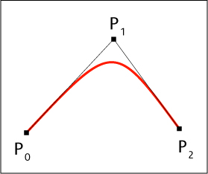
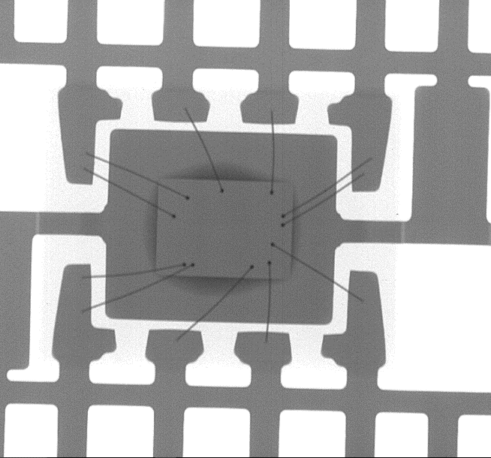
#3: Bezier Line Object Detection
- Goal: replace boxes with Bezier Lines for specialized use cases - Example applications: wire detection in microchip x-ray images, root detection

